Slide 1
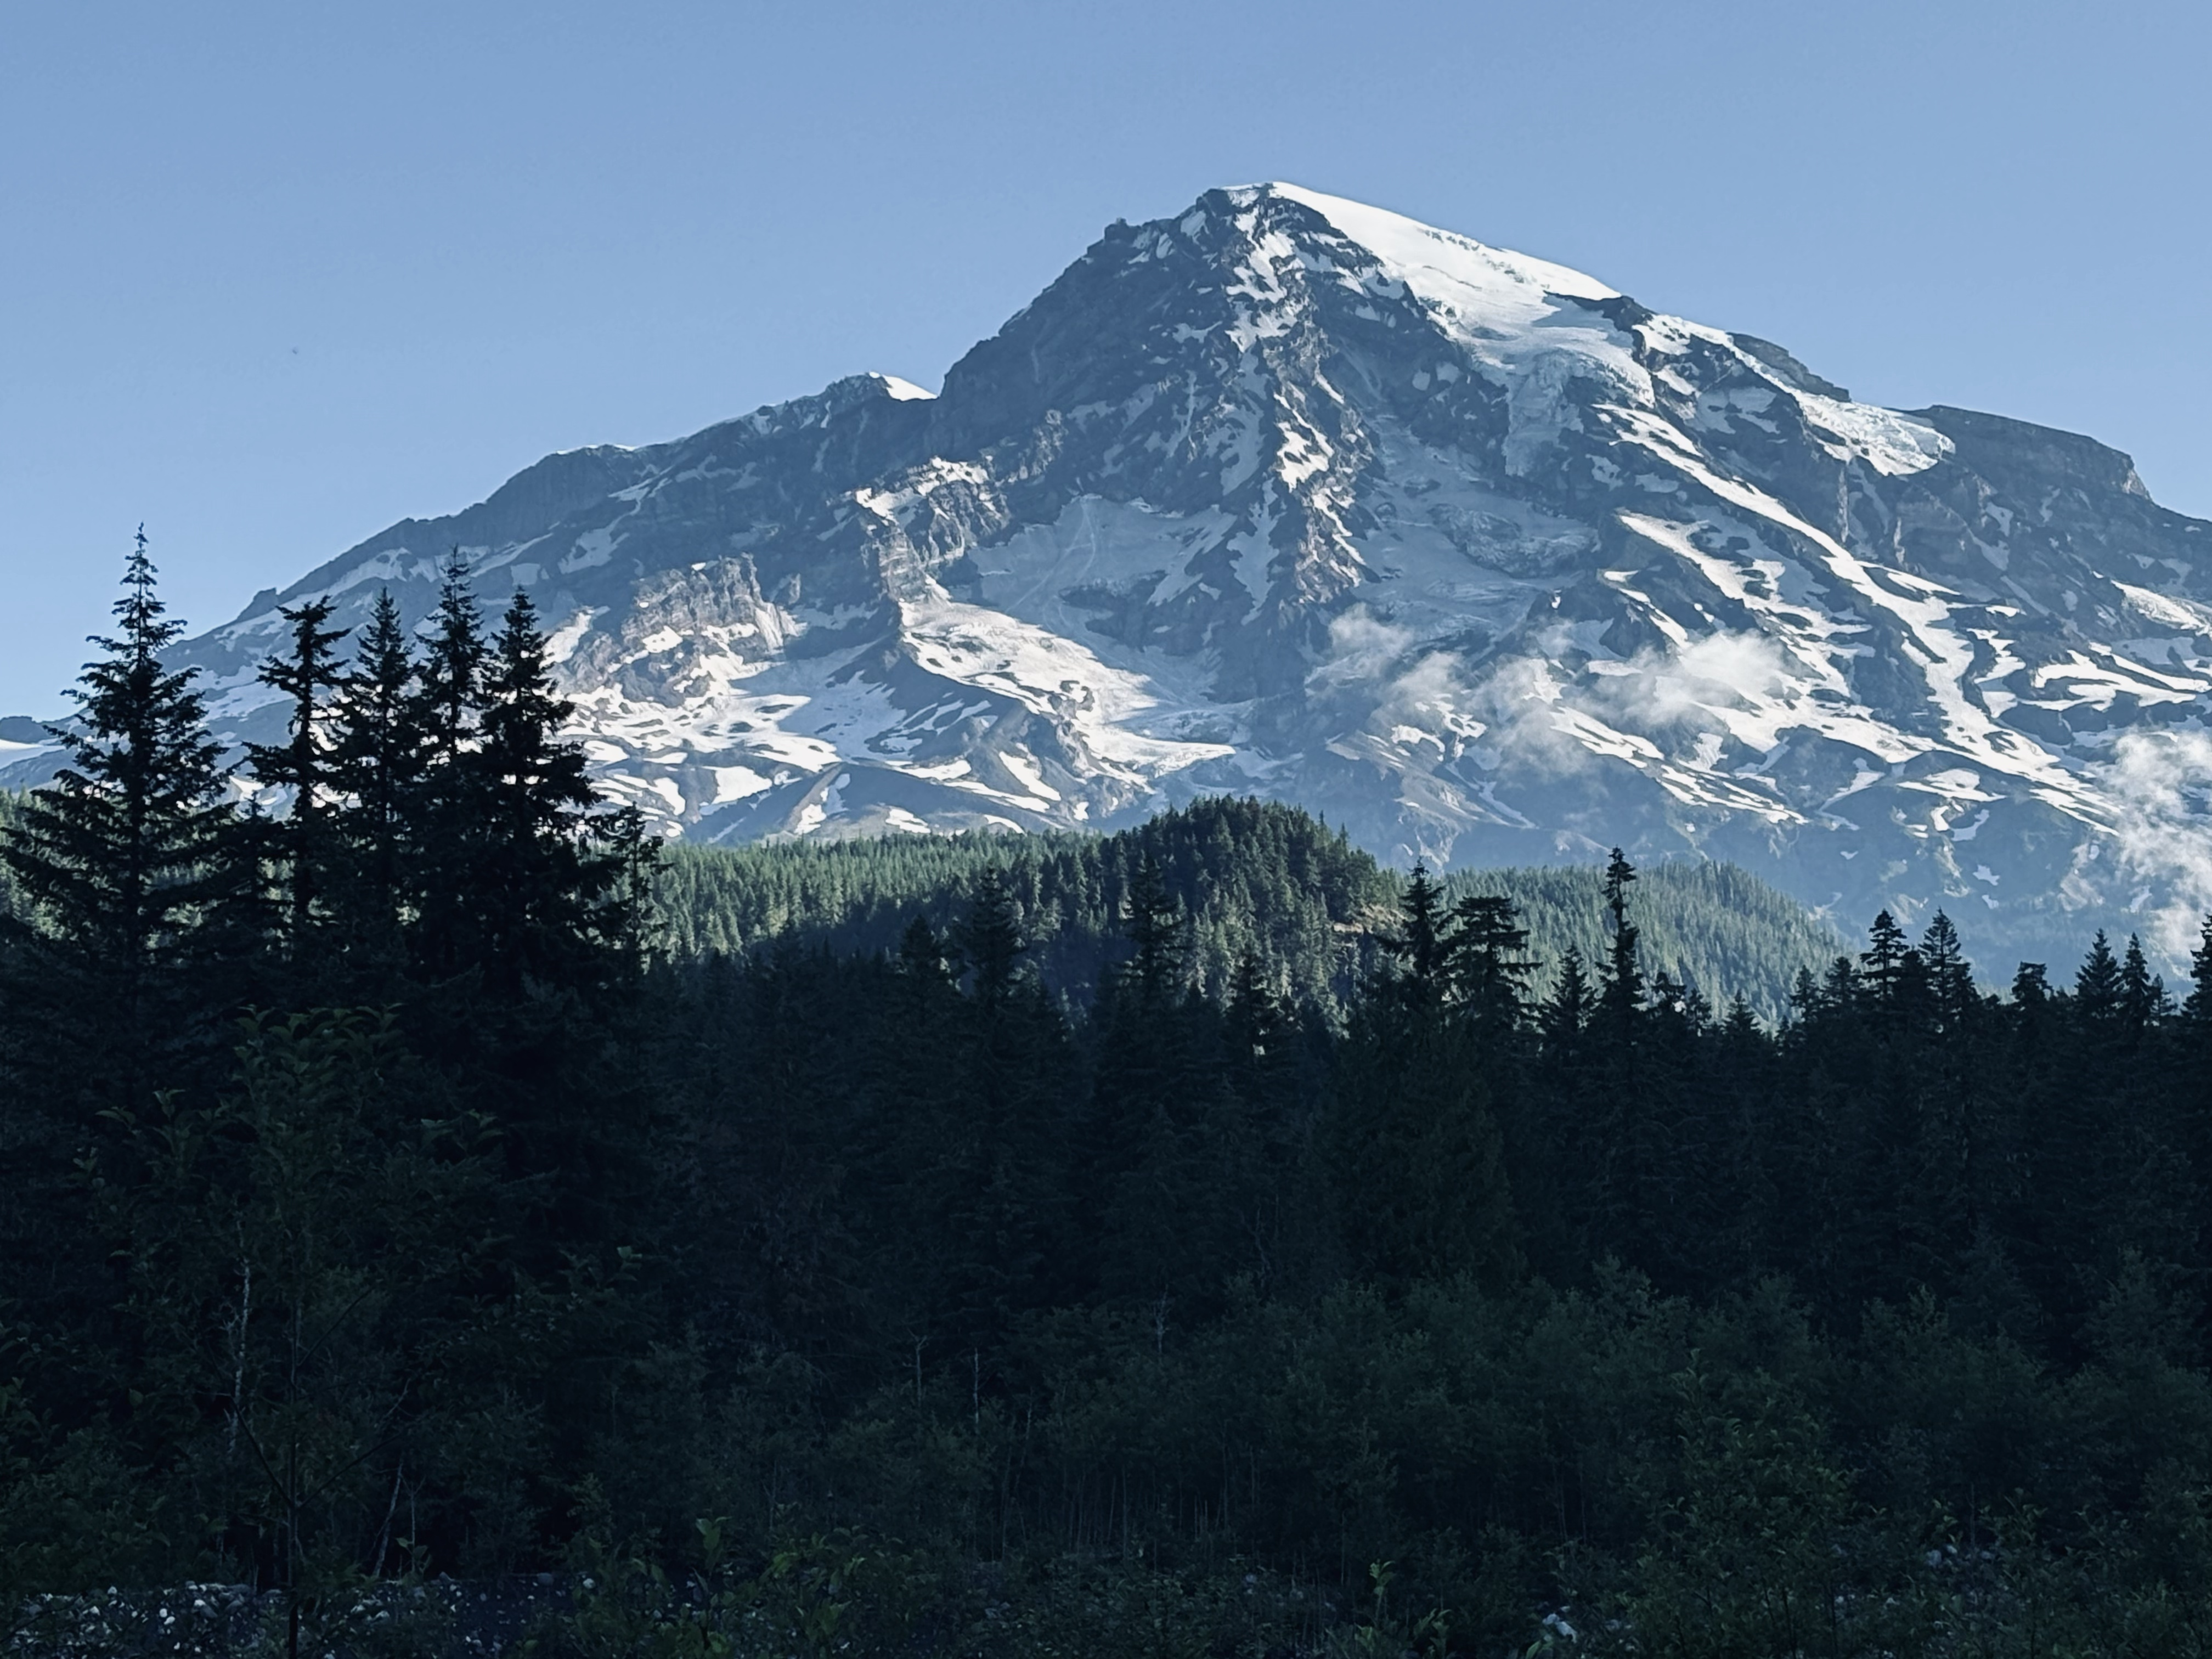


Life on a Budget: Reproduction-growth Trade-Offs in Masting Trees
Xiaomao Wang
Temporal Ecology Lab
Faculty of Forestry, University of British Columbia
Oct 21 2025
Notes:
Hi everyone! My name is Mao, and I’m a PhD student in Lizzie’s lab. I really wish I could be there in person today, but because of my visa issue, I couldn’t make it. So I am here, remotely, doing my best with the resources I’ve got — just like the trees I’m going to talk about.

Slide 2



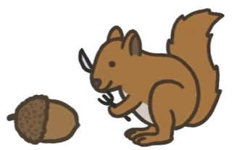
Masting
Masting year
Masting year + 1
Notes:
I’m sure y’all are familiar with masting. Masting is a reproductive strategy that occurs at the population level, characterized by high variability in reproduction from year to year.
It’s thought to help reduce seed predation by overwhelming predators in mast years — so even though predators get a feast, plenty of seeds still survive. In low-seed years, predator populations can’t build up, which helps improve long-term regeneration success. Like in this cartoon: in a mast year, everyone’s happy — and some seeds still make it!

Slide 3

Resources allocation
Defence
Growth
Reproduction
Storage
Notes:
So why does masting happen?
If producing more seeds improves regeneration, why don’t trees just produce a lot every year?
The main reason is limited resources. Trees can only acquire so much carbon, water, and nutrients each year — and they have to divide those resources among several different life processes. Broadly speaking, we can group these into four categories: defence, growth, reproduction and storage. Defense, like producing chemical compounds to deter herbivores or pathogens, usually uses a smaller share of resources and is often triggered only by stress.
Storage is important when thinking about building up energy reserves, but it’s not always a big allocation in a given year especially when the resource itself is limited for other more critical processes.
That leaves growth and reproduction, which are typically the most resource-demanding processes and the ones that most directly influence a tree’s long-term survival and success. Then we can ask a follow up question, how is resource split to these two processes?

Slide 4
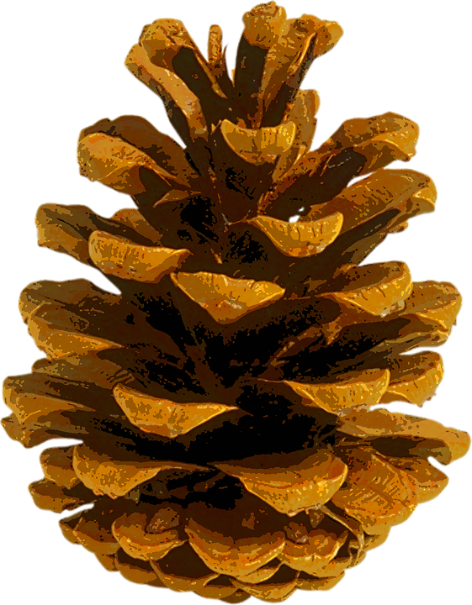
Resources allocation
+
Growth
+
Reproduction
Notes:
First, let’s imagine a tree that splits its resources equally between growth and reproduction every year.
In a poor year, when there are not many resources are available. We ended up not having enough resources for both growth and reproduction, we will only see very little in growth and very few seeds.

Slide 5
Resources allocation
++
Growth
++
Reproduction
Notes:
In a good year, the tree has more resources available to support more growth and more reproduction.
This model assumes resources going to growth and reproduction equally— just simply resource matching based on what's available. In this context, masting happens when there are lots of resources available, and we should be able to observe lots of growth at the same time when masting happens.

Slide 6
Growth-reproduction trade-off
+
Growth
++
Reproduction
Notes:
But there's another possibility — especially when we consider the masting.
Instead of equal resources allocated to both processes, the tree might shift priorities: in a more productive year, like mast years, more resources goes to reproduction at the expense of growth.
So when trees invest heavily in reproduction, we see reduced growth — suggesting a trade-off, not just resource matching.

Slide 7
Growth-reproduction trade-off
Growth
++
+
Reproduction
Notes:
And more growth is only observed when trees have fewer seeds, for example the years after a masting event. And this is called growth-reproduction trade-off, which we would expect to see in the context of masting event.

Slide 8



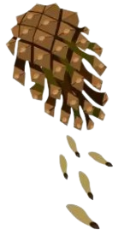

General reproductive cycle
Reproductive organs development
Pollination
Fertilization
Maturation
Dispersal
Notes:
So what controls how trees divide resources between growth and reproduction?
Let’s look at the reproductive cycle in trees. It includes stages like the development of reproductive organs — pollen and seed cones for conifers, or flowering buds in angiosperms.
In many temperate species, these processes start in the fall of the year before seed development. Then comes pollination in spring, followed by fertilization, then seed maturation, and finally seed dispersal.
All of these stages must succeed for a successful seed production to occur — and they’re all highly sensitive to environmental conditions.

Slide 9

Environmental conditions
‘Positive’ environmental events (environmental cues)
‘Negative’ environmental events (environmental vetos)
More seed (masting)
More growth (non-masting)
Trade-offs help to maximize plants’ fitness when resources are limited
Notes:
Some environmental conditions favor reproduction, and we call them environmental cues. For example, a warm, dry spring can enhance pollination and trigger a reproductive response — more resources go into seeds, leading to a mast year.
Other more negative events act as vetoes — like a late frost, which can damage flowers or developing seeds. In those years, trees may shift resources back to growth instead.
So the environment doesn’t just influence how much resource is available — it affects where those resources go.

Slide 10
Climate change
Wait, am I the only one get excited ??
Changes of environmental cues
Disruption of synchrony
Uncertainties of resources allocation
Notes:
Because masting depends on environmental cues and vetoes, climate change could disrupt this balance in several ways.
First, cues like warm, dry springs may become more frequent or less predictable, which could shift the timing or frequency of reproduction. But if these cues are followed by veto events — like late frosts or drought — seed development could fail, making reproductive investment less successful.
Second, individual trees may start responding differently to changing conditions because of intraspecific variation. That loss of synchrony across the population will weaken the advantage of masting, since predator satiation only works when many trees reproduce at the same time.
Finally, climate change could alter resource availability itself — through changes in temperature, and soil moisture — affecting how much trees can allocate to growth or reproduction in the first place.
All of this makes it harder to detect clear trade-offs and may shift how — or even whether — trees mast in the future.

Slide 11
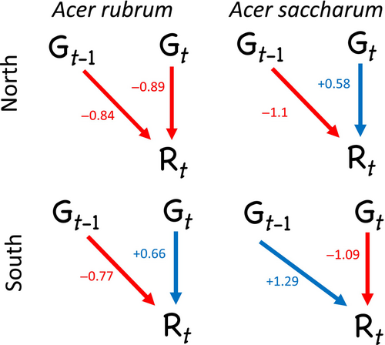
Previous studies
40% no trade-off; 40% trade-off; 20% climate dependent
Climate is very critical, the reproductive cycle is important
Vincent, C., & Ibáñez, I., Ecosphere, 2024
Notes:
There are about 15 published paper trying to look for if there’s a trade-off between growth and reproduction regarding masting. There are many studies on oak trees specifically. When we look at the result, it’s kind of a mixed picture.
About 40% of studies find no significant trade-off. Another 40% states clear evidence for a trade-off, and around 20% suggest that the relationship depends on climate independently, and it may disappear when remove climate effects.
For example, a recent study on two maple species at different latitudes found that the relationship between growth and reproduction changed depending on latitude, and both their growth and reproduction responded to climatic signals differently.
They also looked at growth in the year before a mast year — since reproductive development starts earlier — showing how important it is to understand the timing of resource allocation shifts.

Slide 12
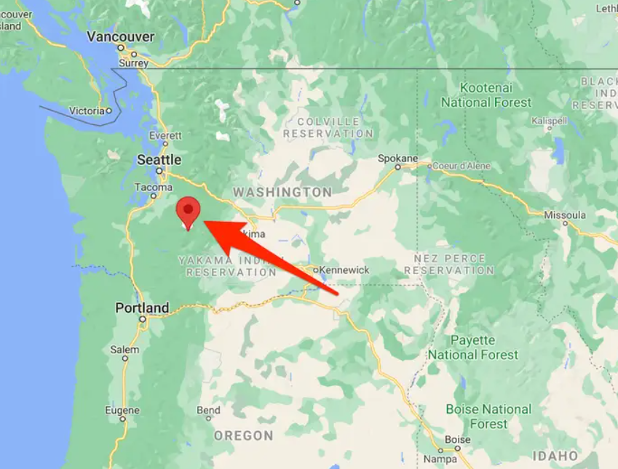
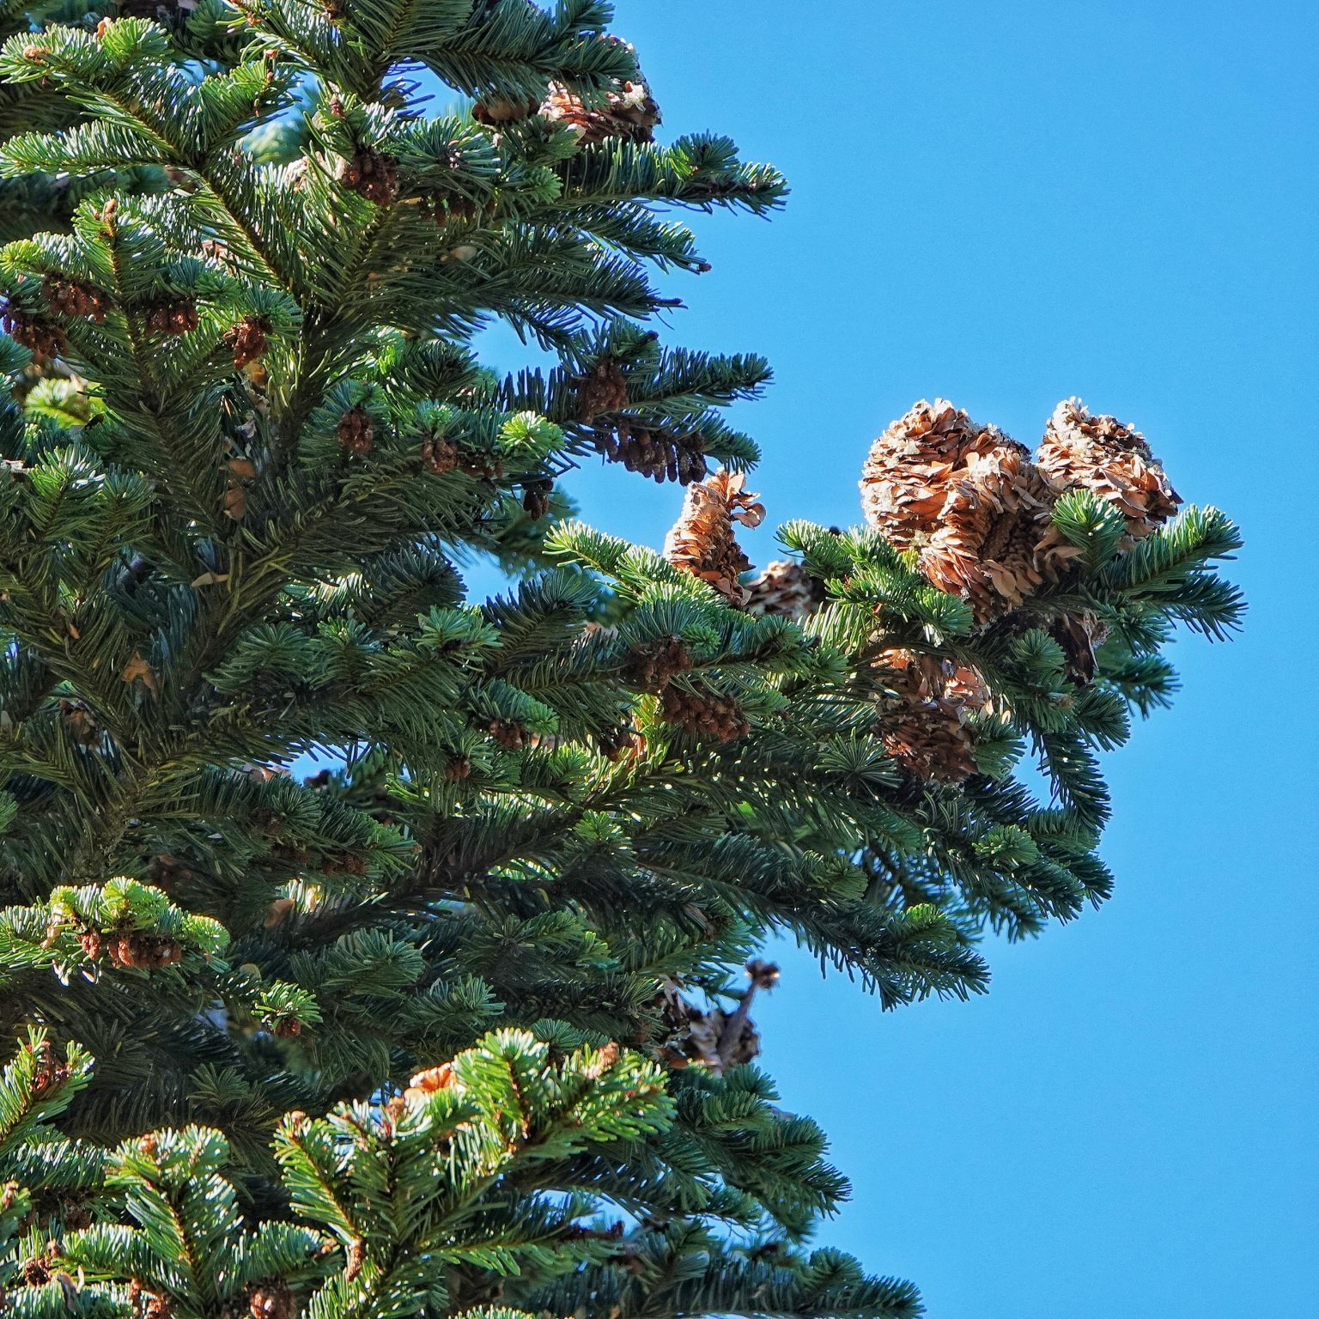
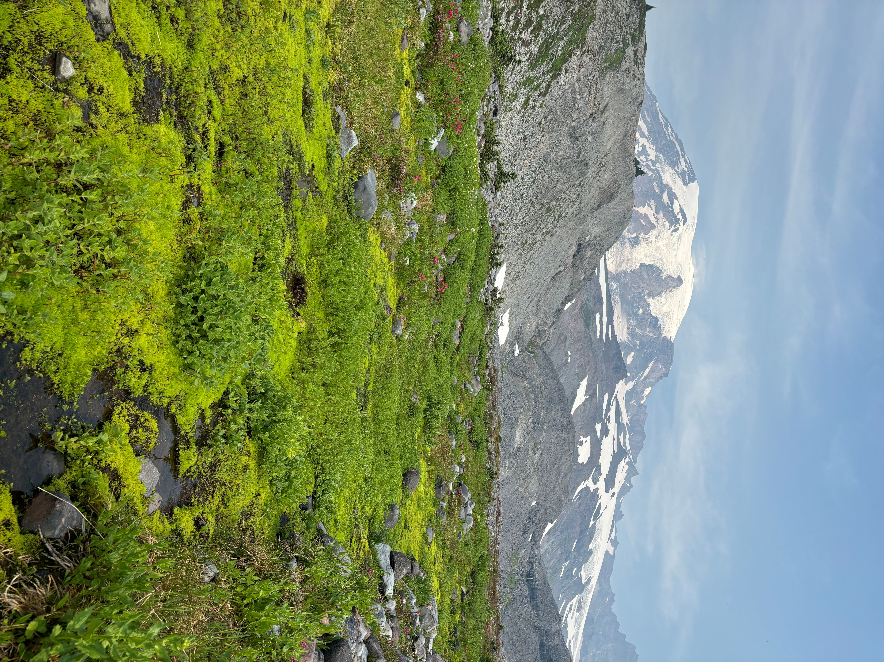
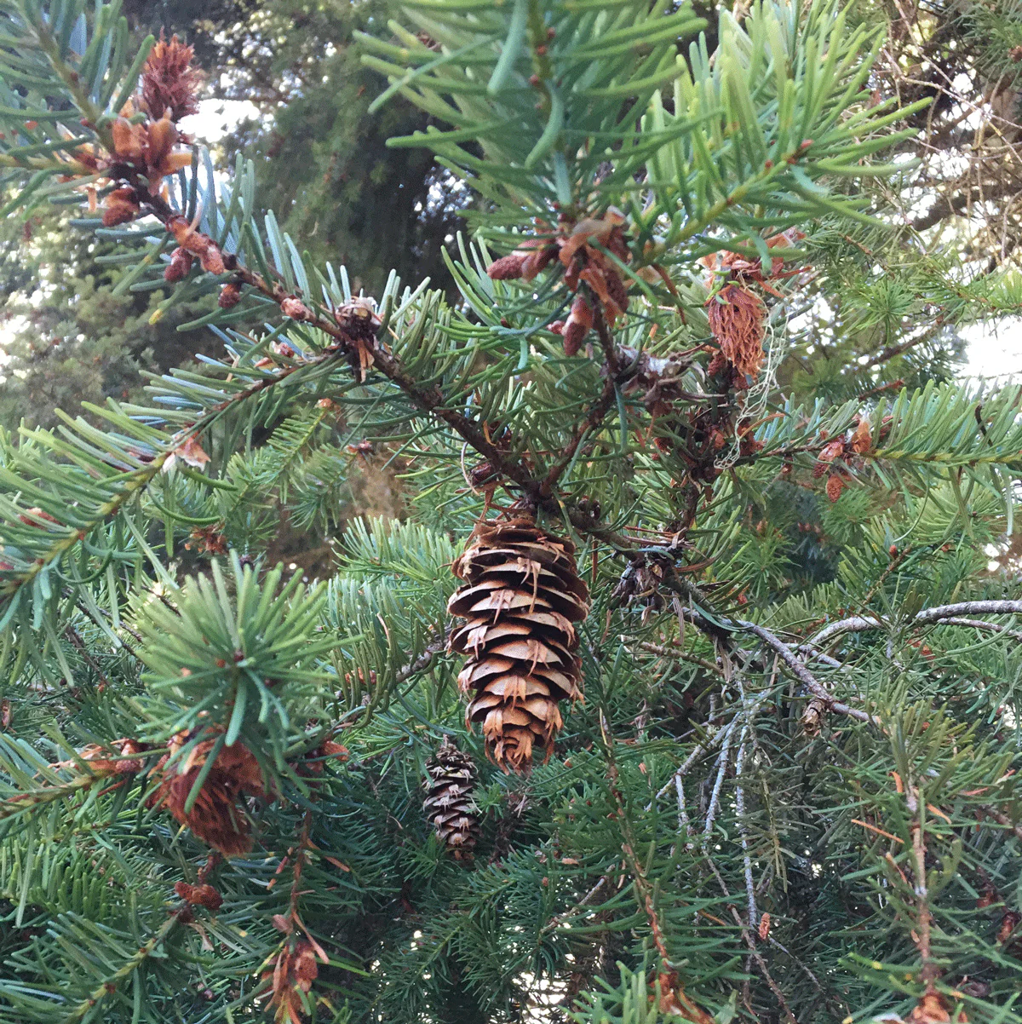
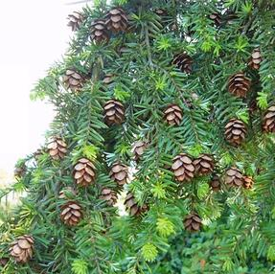
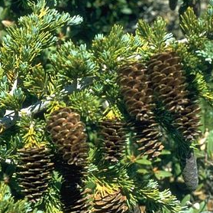
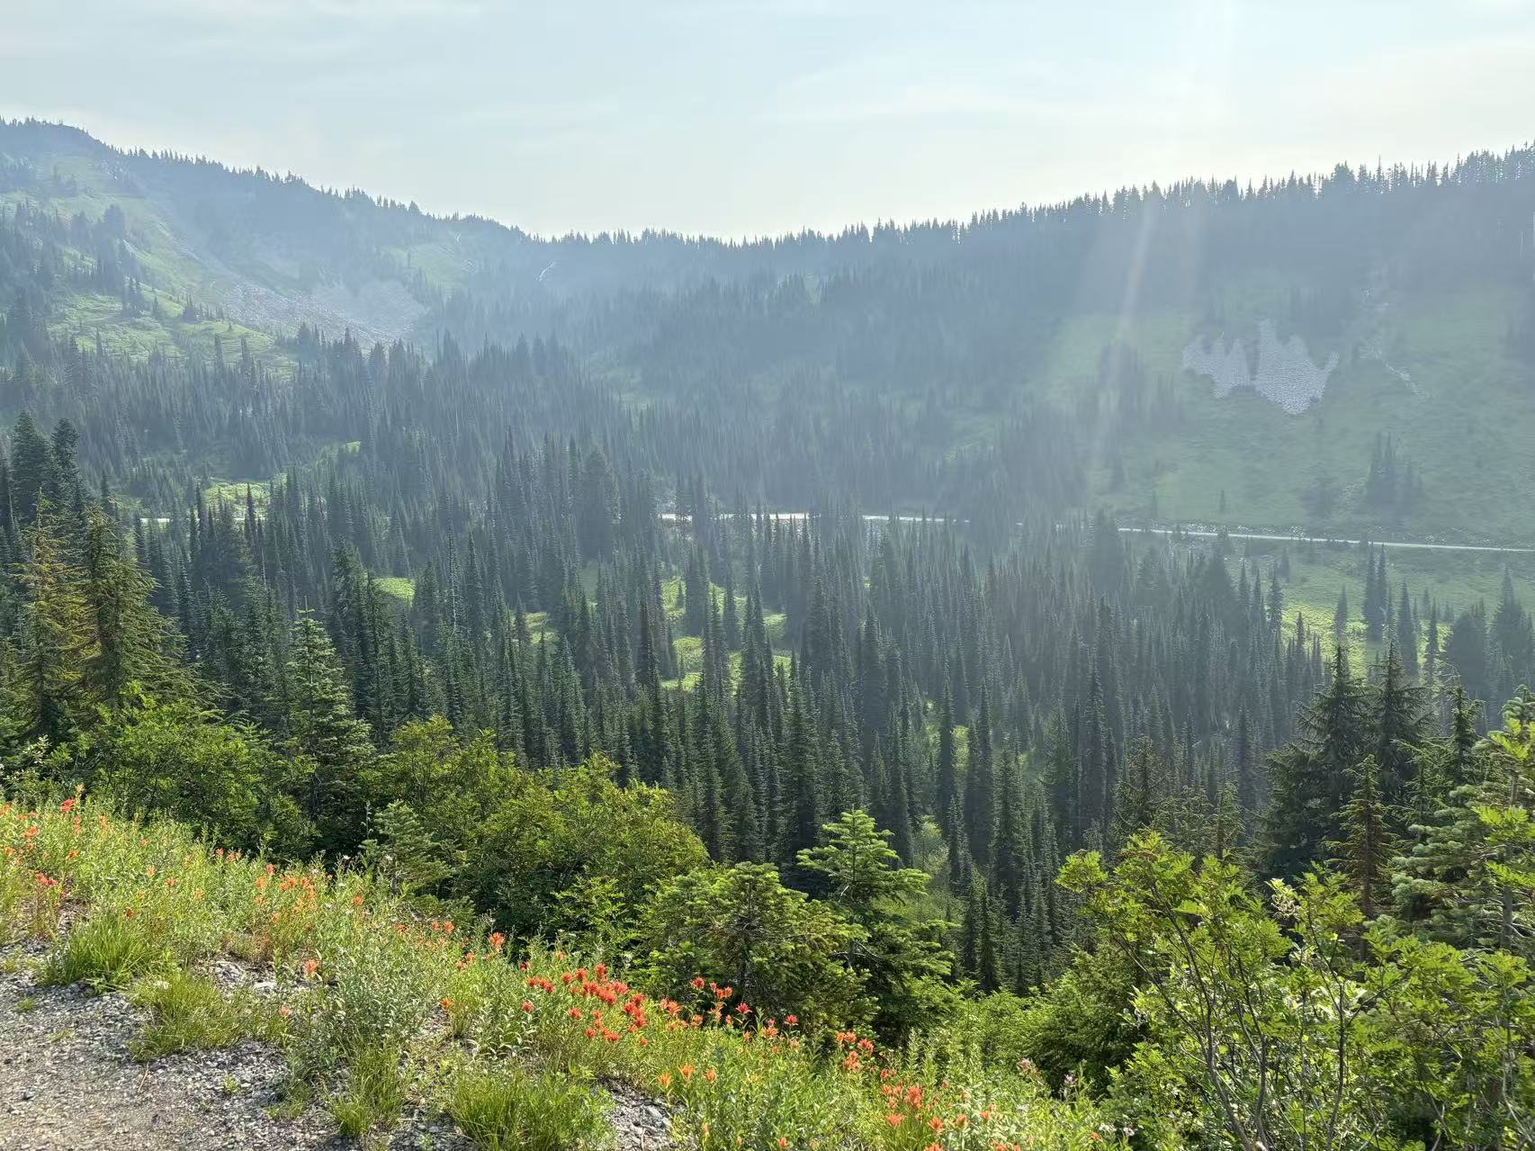
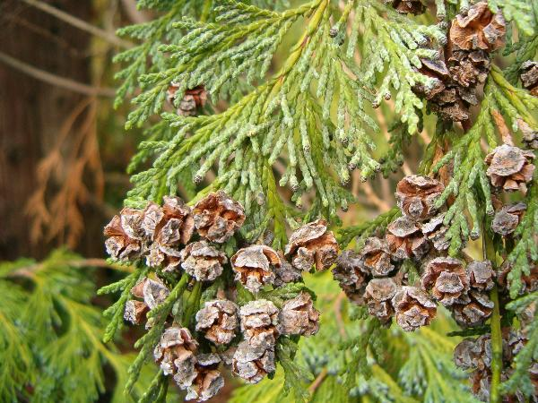
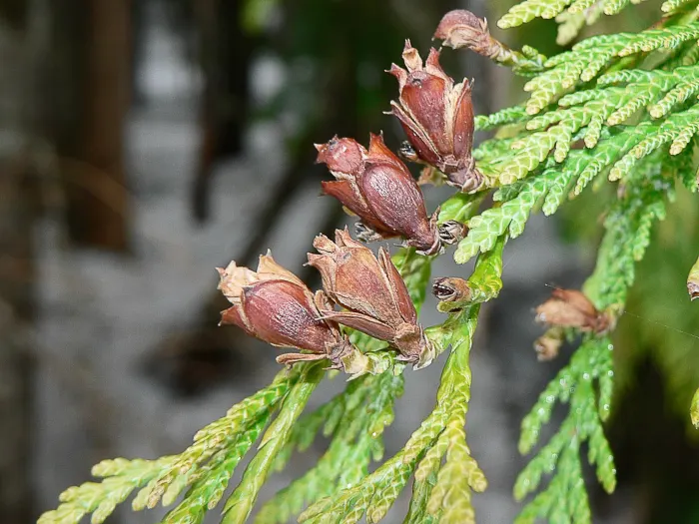
Abies amabilis
Pacific silver fir
Pseudotsuga menziesii
Douglas-fir
Tsuga heterophylla
Western hemlock
Tsuga mertensiana
Mountain hemlock
Callitropsis nootkatensis
Yellow cedar
Thuja plicata
Western Redcedar
Notes:
For my project, I’m investigating whether a growth–reproduction trade-off exists in several conifer species at Mount Rainier National Park.
These species differ in their reproductive cycles — most have two-year cycles, but a couple have more unique timelines.
This lets us test for trade-offs in the year before, during, and after mast years.

Slide 13
Source: iNaturalist
‘Flower’
development
Pollination
Fertilization
Maturation
Dispersal
Abies amabilis
Pacific silver fir
Fall
Winter
Spring
Summer
Fall
Winter
Spring
Summer
Fall
Pseudotsuga menziesii
Douglas-fir
Fall
Winter
Spring
Summer
Fall
Winter
Spring
Summer
Fall
Tsuga heterophylla
Western hemlock
Fall
Winter
Spring
Summer
Fall
Winter
Spring
Summer
Fall
Tsuga mertensiana
Mountain hemlock
Fall
Winter
Spring
Summer
Fall
Winter
Spring
Summer
Fall
Callitropsis nootkatensis
Yellow cedar
Fall
Winter
Spring
Summer
Fall
Winter
Spring
Summer
Fall
Thuja plicata
Western Redcedar
Fall
Winter
Spring
Summer
Fall
Winter
Spring
Summer
Fall
Notes:
For my project, I’m investigating whether a growth–reproduction trade-off exists in several conifer species at Mount Rainier National Park.
These species differ in their reproductive cycles — most have two-year cycles, but a couple have more unique timelines.
This lets us test for trade-offs in the year before, during, and after mast years.

Slide 14
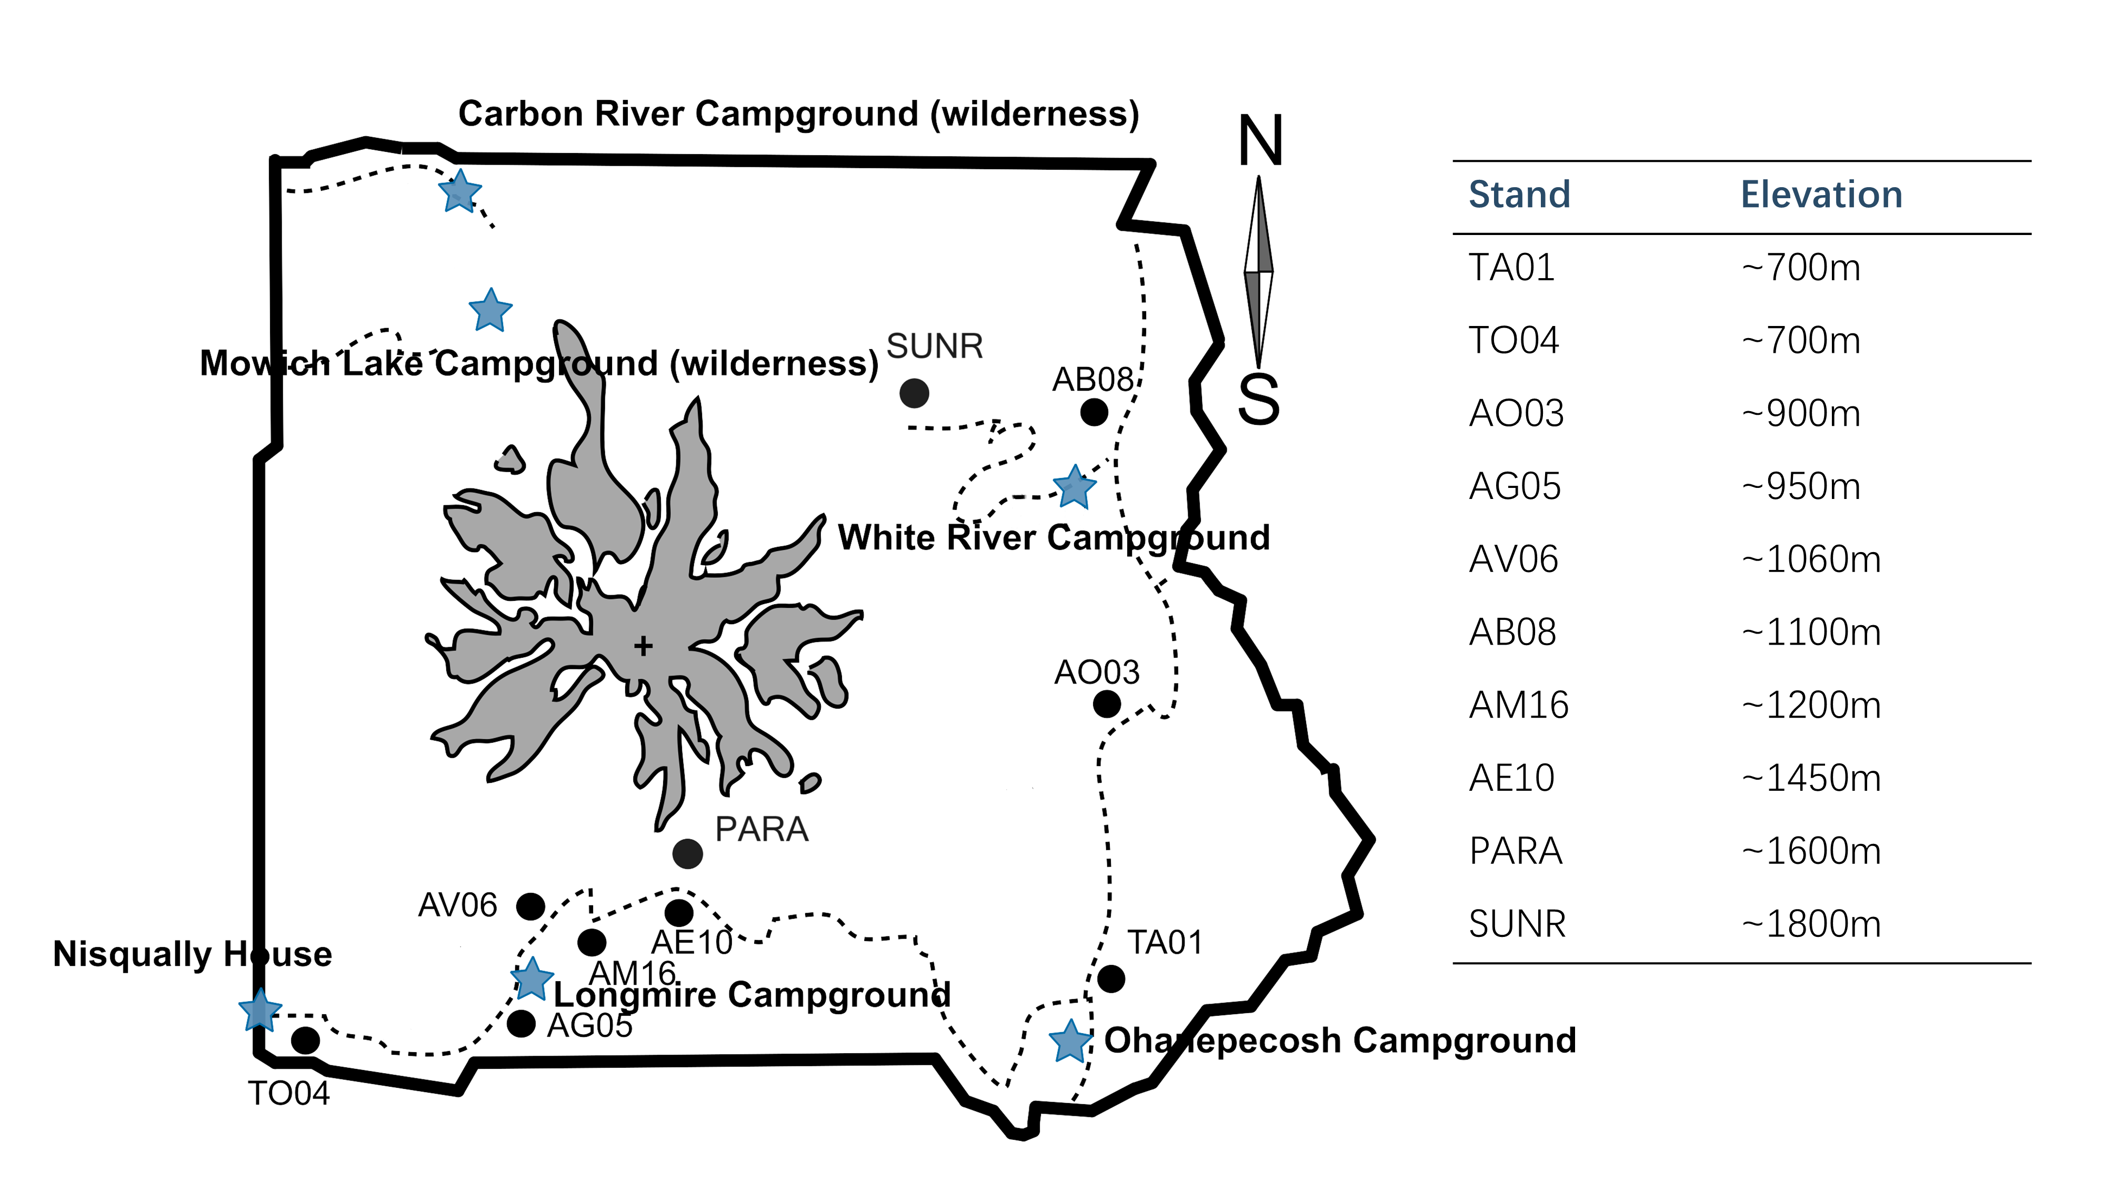
Different elevation indicating different resources availability, proxy of climate change
Notes:
Mount Rainier also offers a elevational gradient.
And among the species we have, some of them span wide ranges, while others are restricted to low or high elevations.
Elevation can serve as a proxy for resource availability and climate variation, giving us a way to test how reproductive strategies shift with changing environmental conditions.

Slide 15
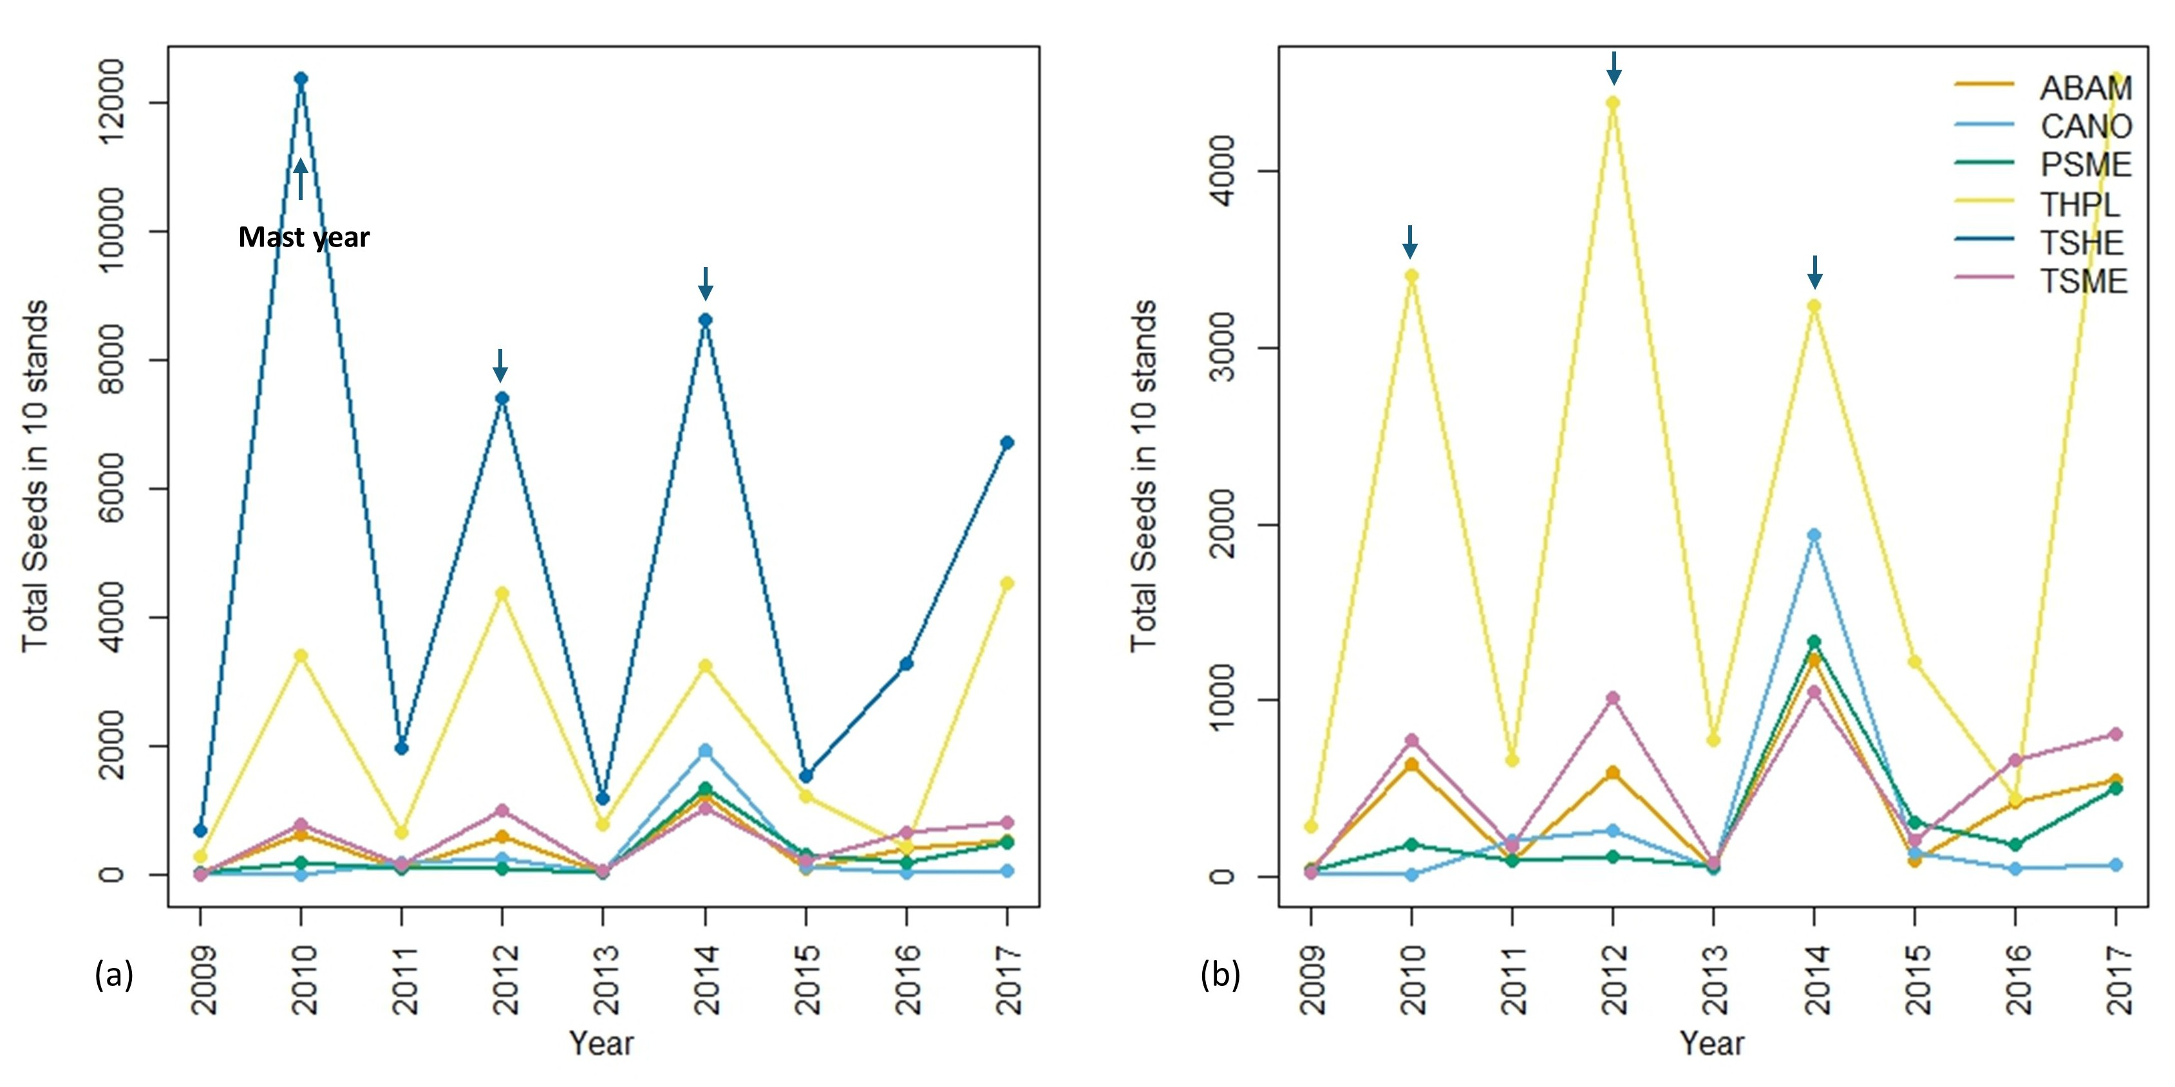
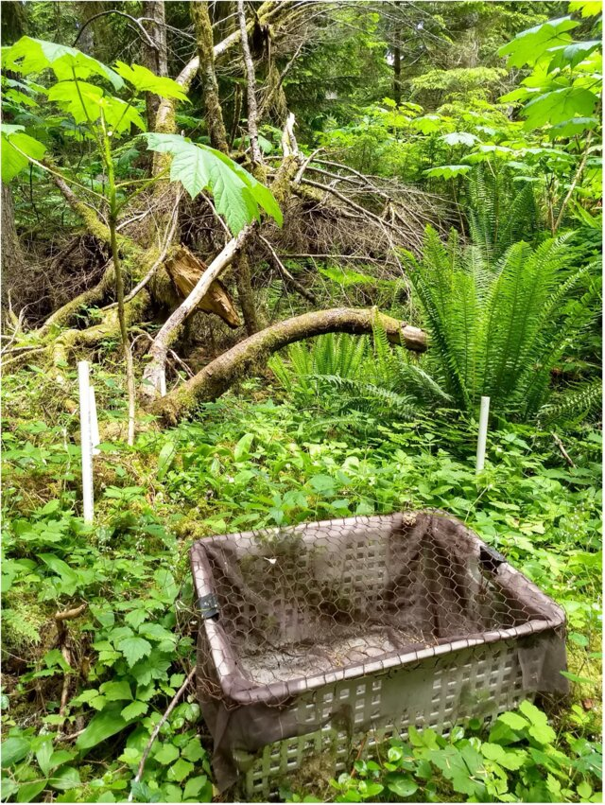
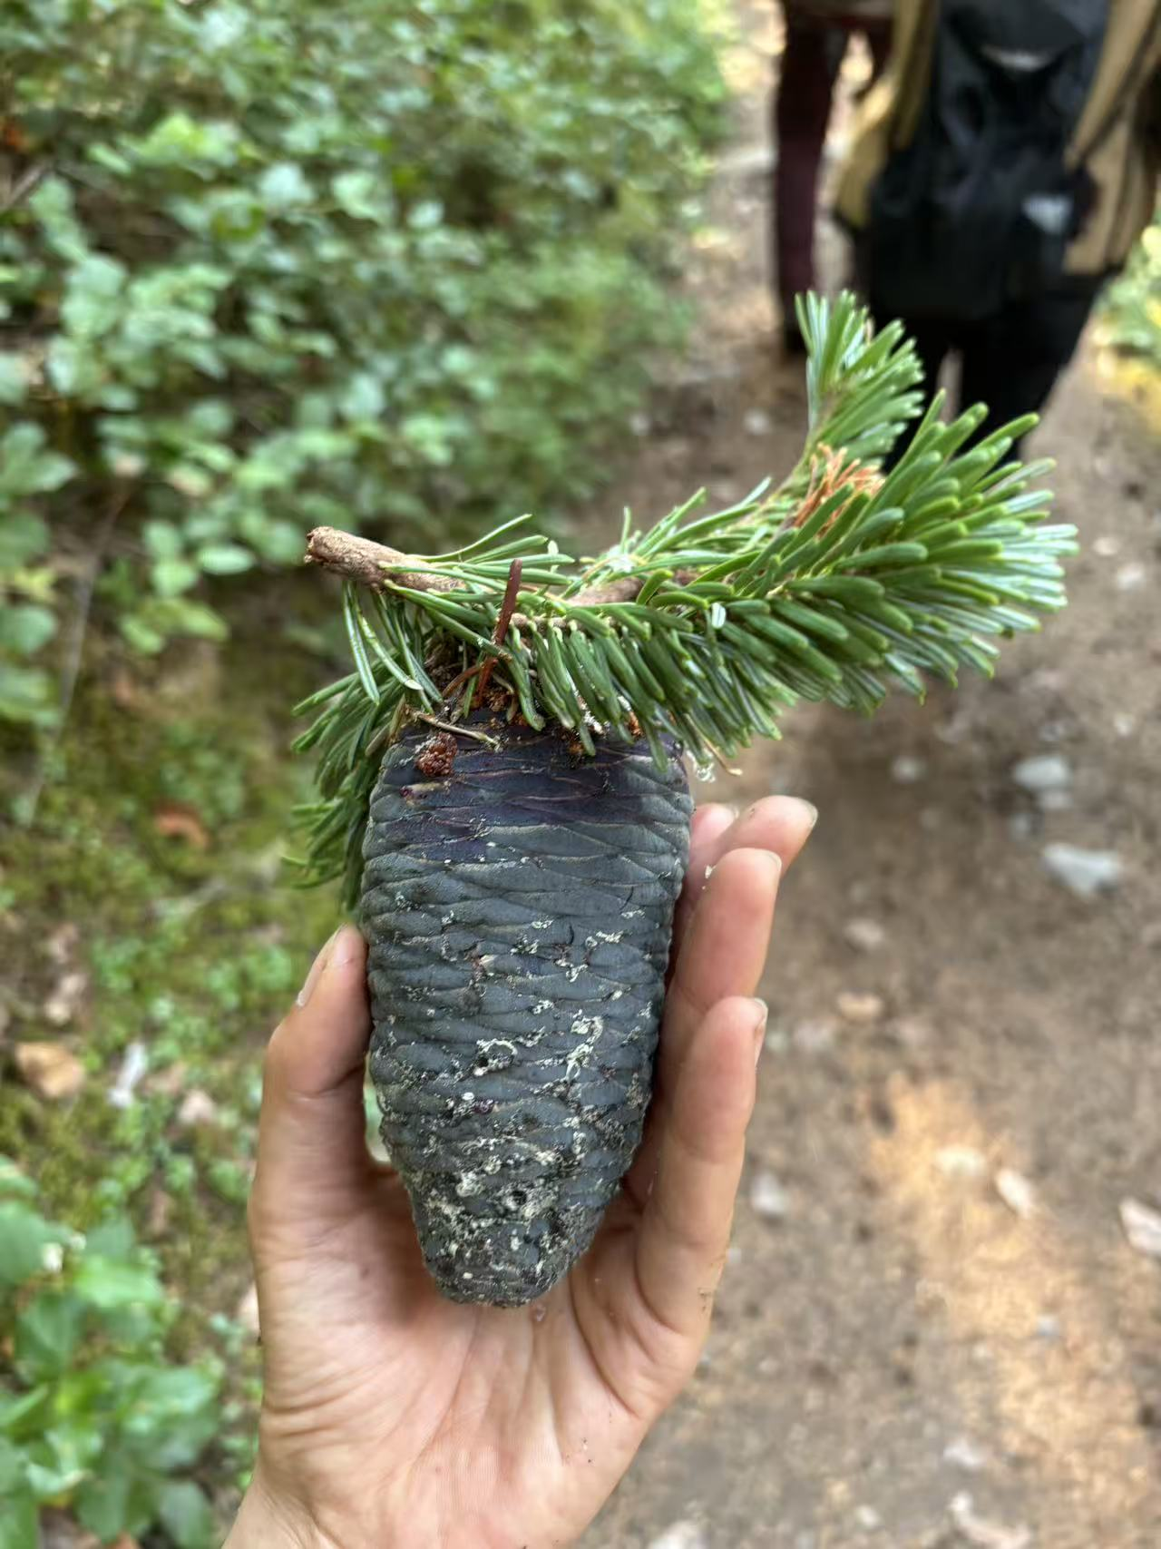
Notes:
For reproductive data, I’m using long-term seed trap data from Janneke’s lab.
Seed traps were placed across different forest stands to monitor annual seed production.
This kind of long-term dataset is incredibly valuable for studying masting patterns and linking them to both climate and growth. And we believe there’s enough variation in seed counts to identify mast years within the data.

Slide 16
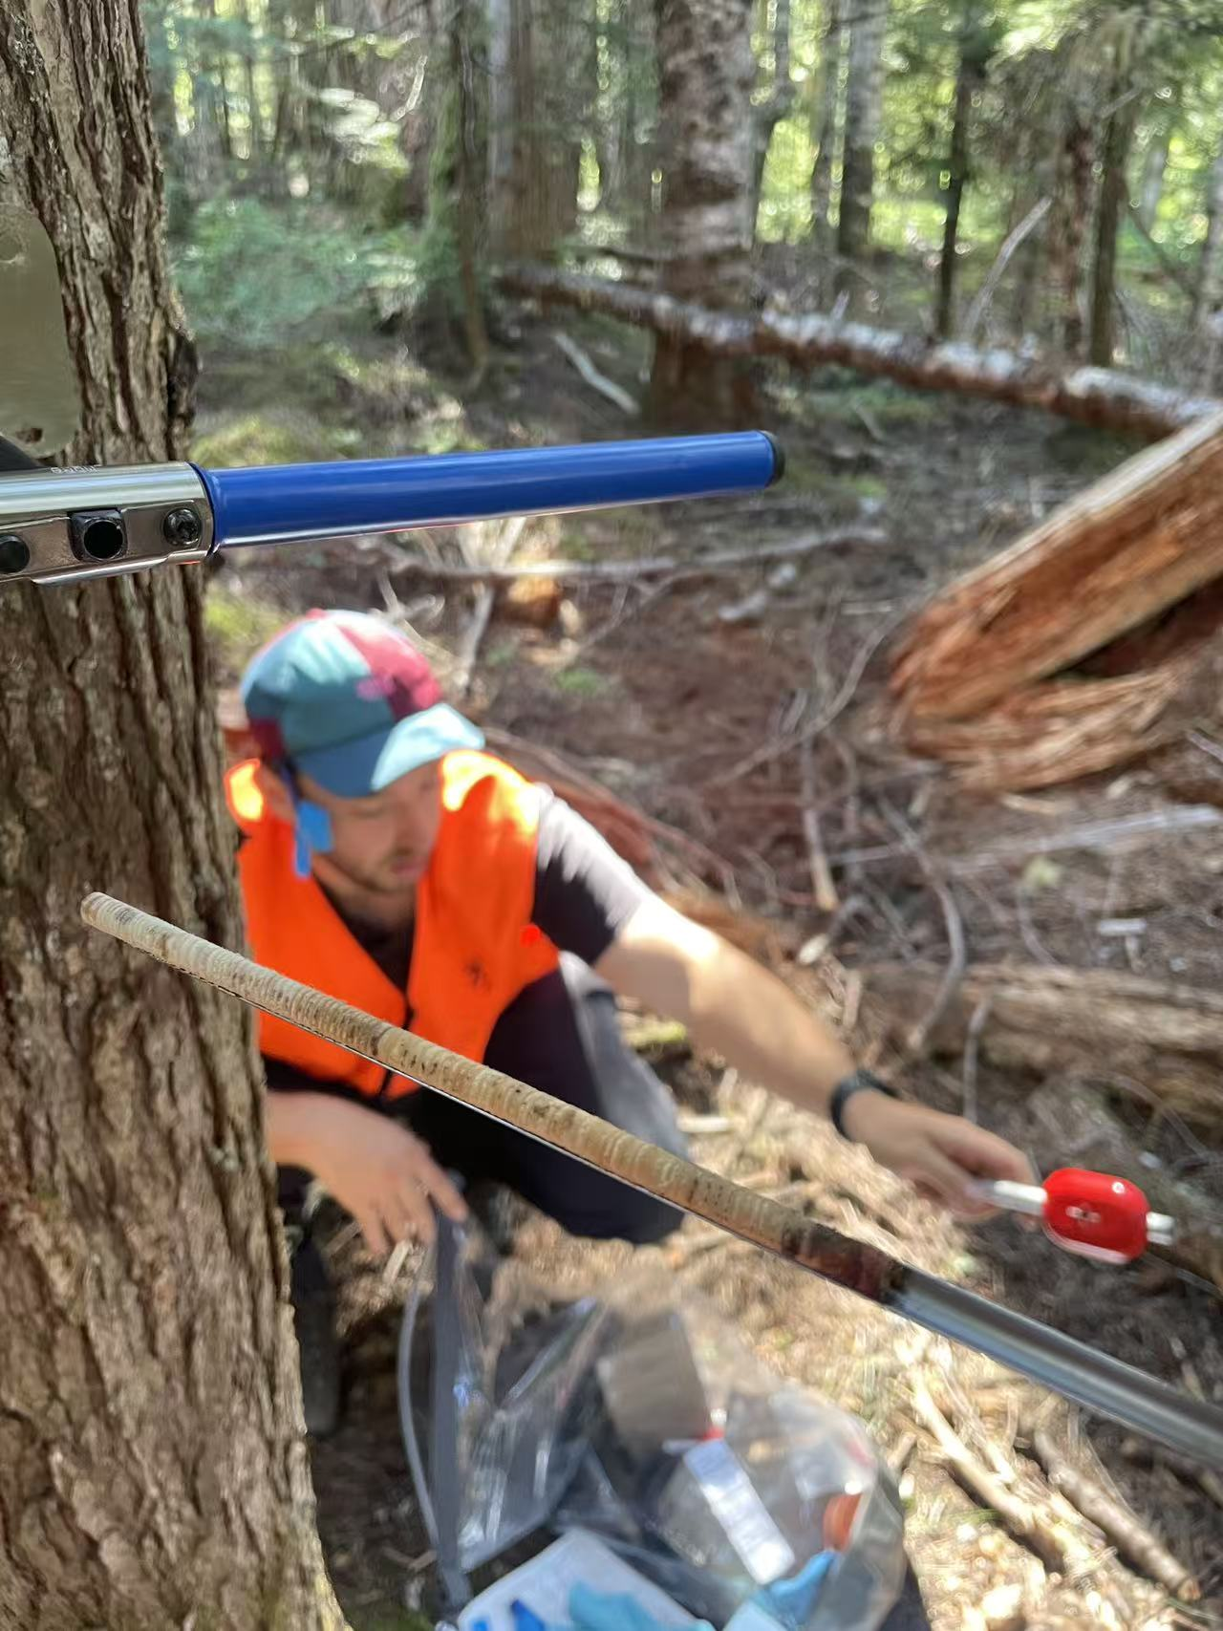
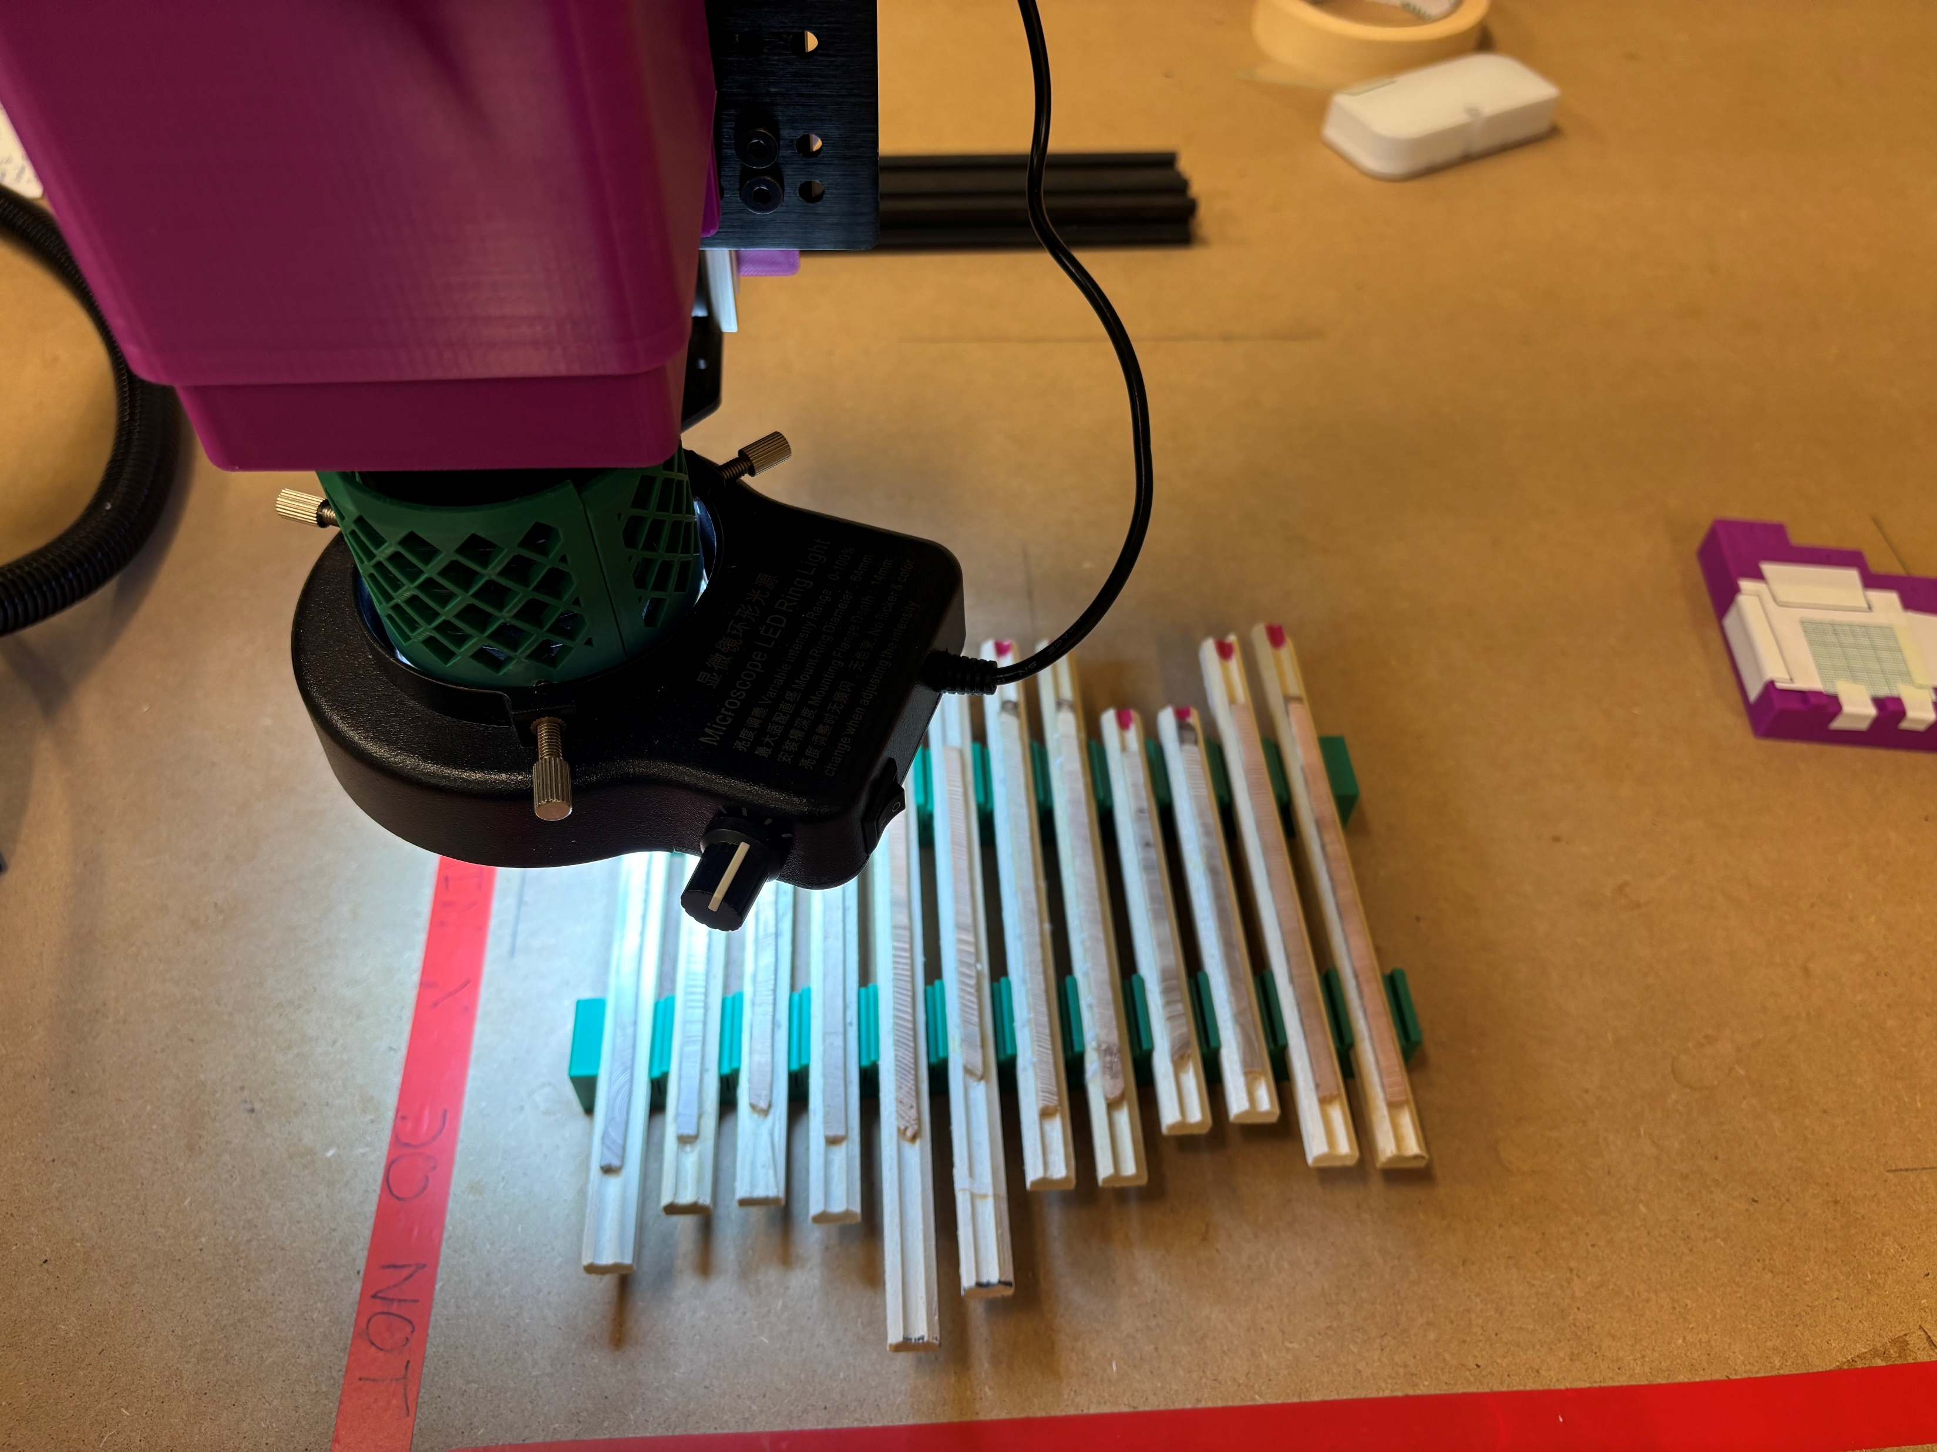
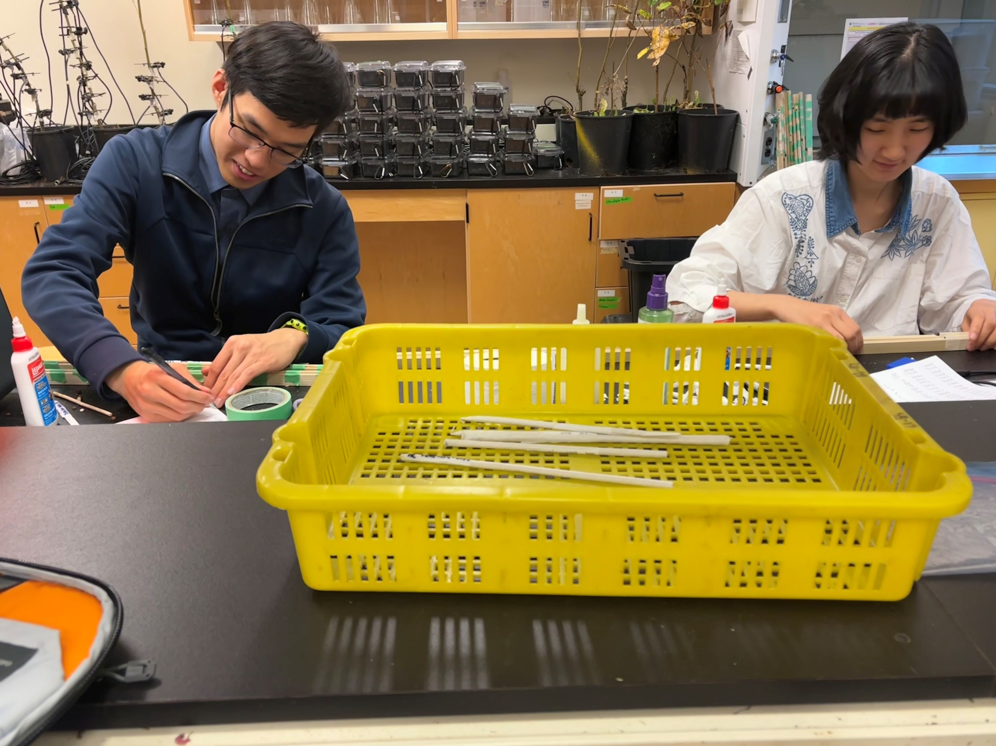
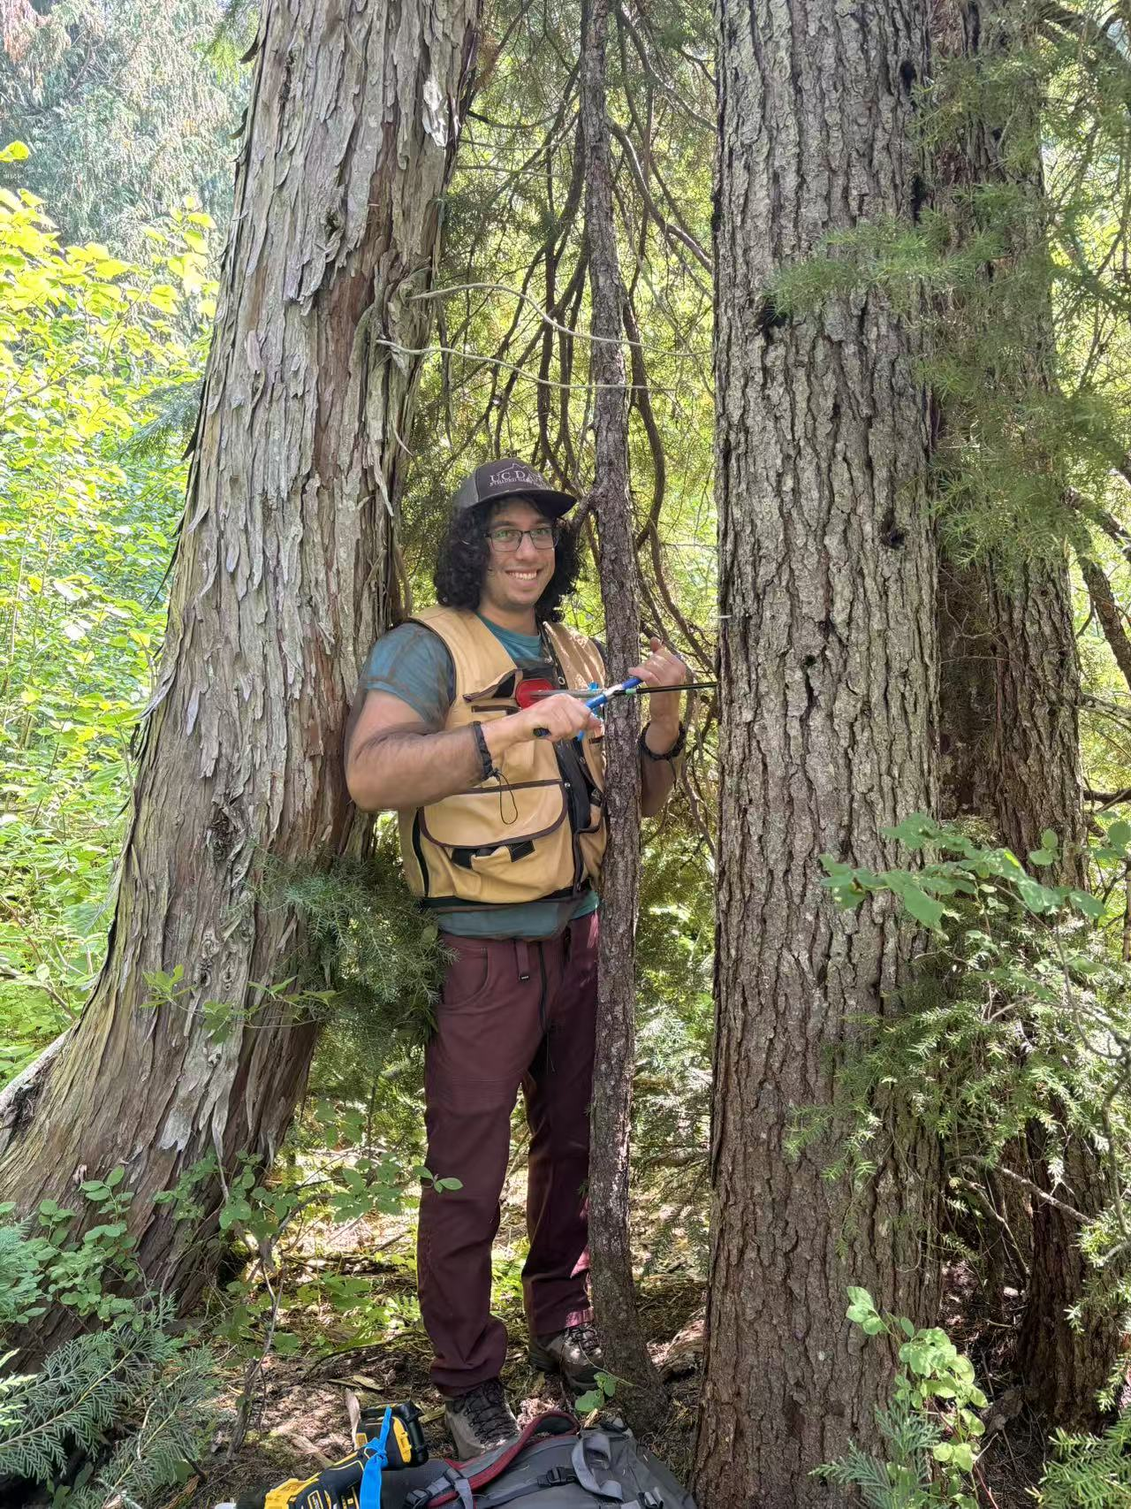
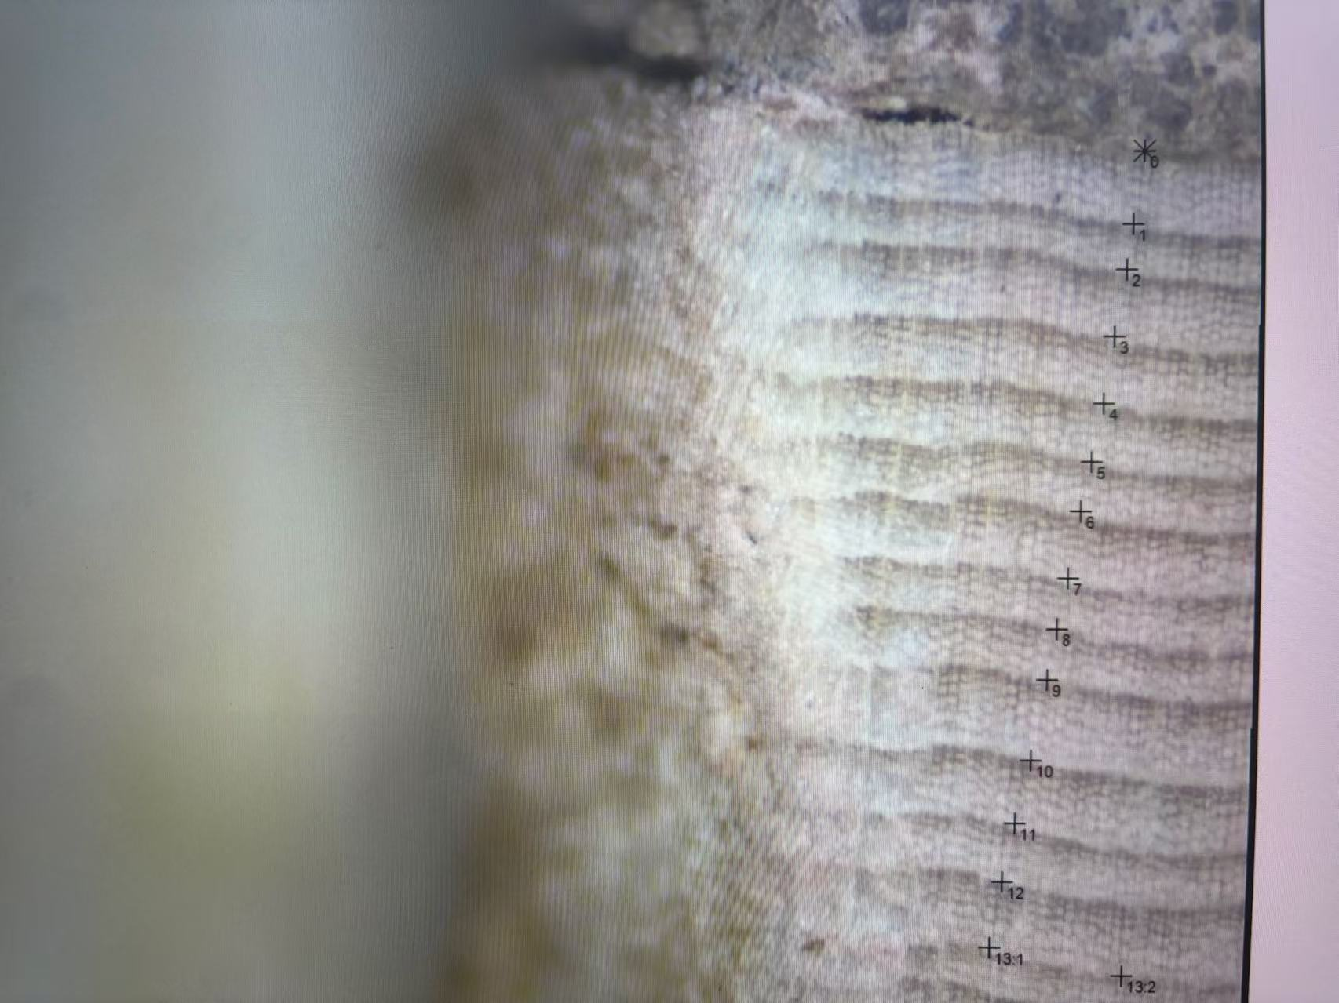

Coring Mounting Sanding Scanning Measuring Cross-dating Analyzing
Notes:
For the growth data, I’m using radial growth —how much the trees grow in diameter each year, since this might account for the most growth for adult conifer trees.
Last year we spent a mount at Mount Rainier, with help from an amazing field crew, we collected over 1,000 tree cores from different stands across elevations.
Processing them is a big job — I’m currently scanning them with a custom camera built by a former engineering student in our lab.
These cores will give us annual-resolution growth data to compare with seed production.

Slide 17
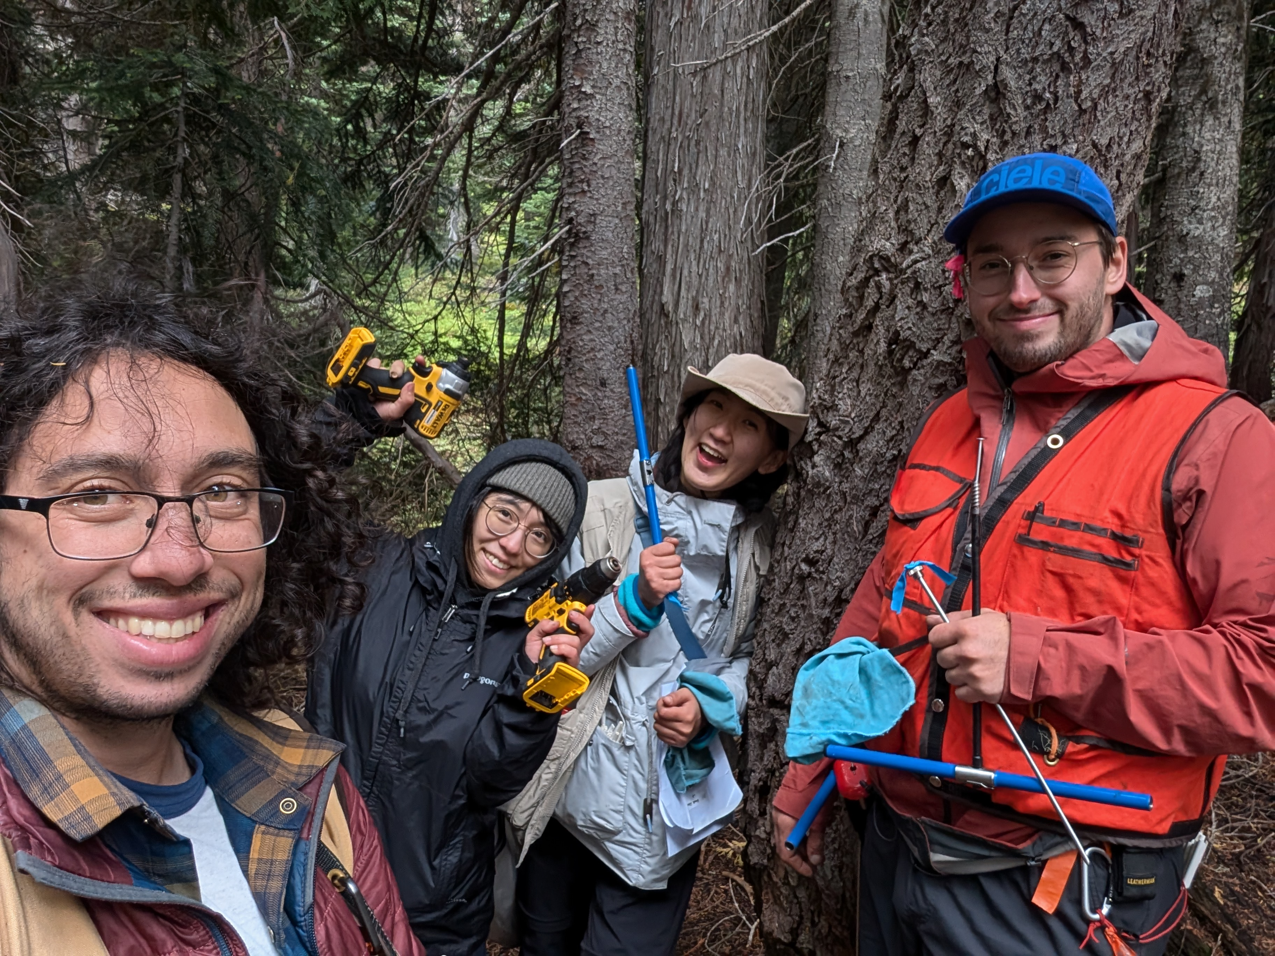
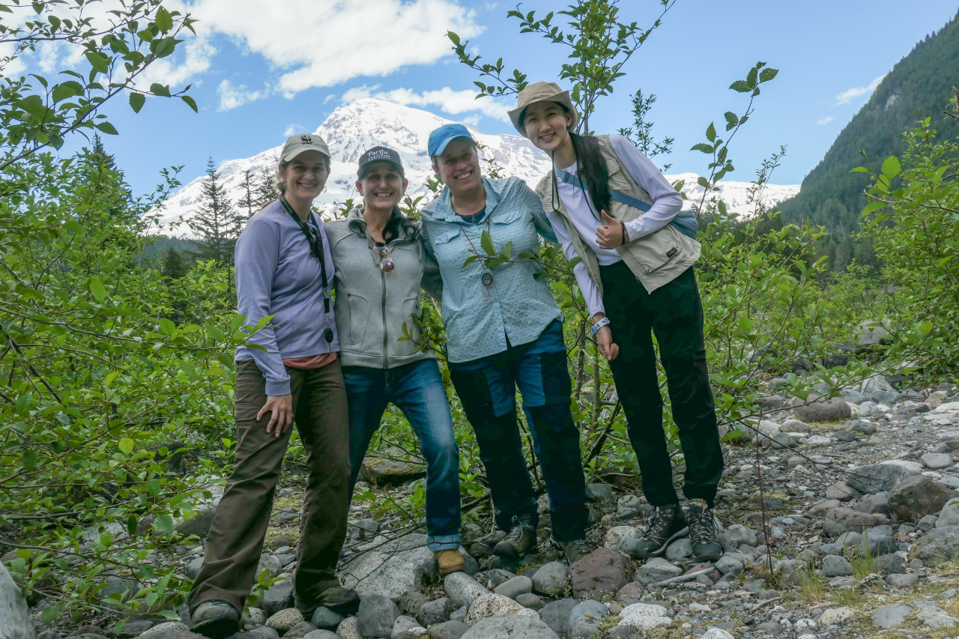
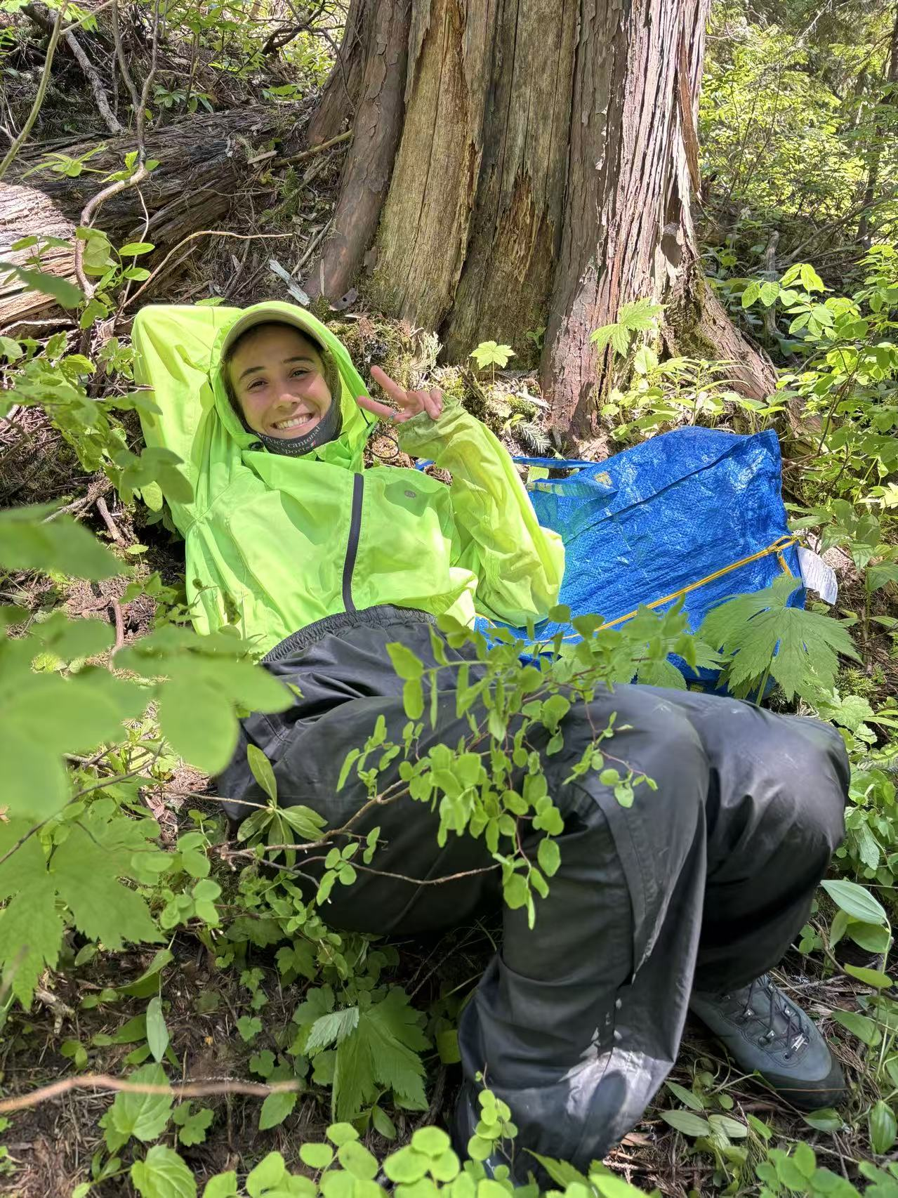
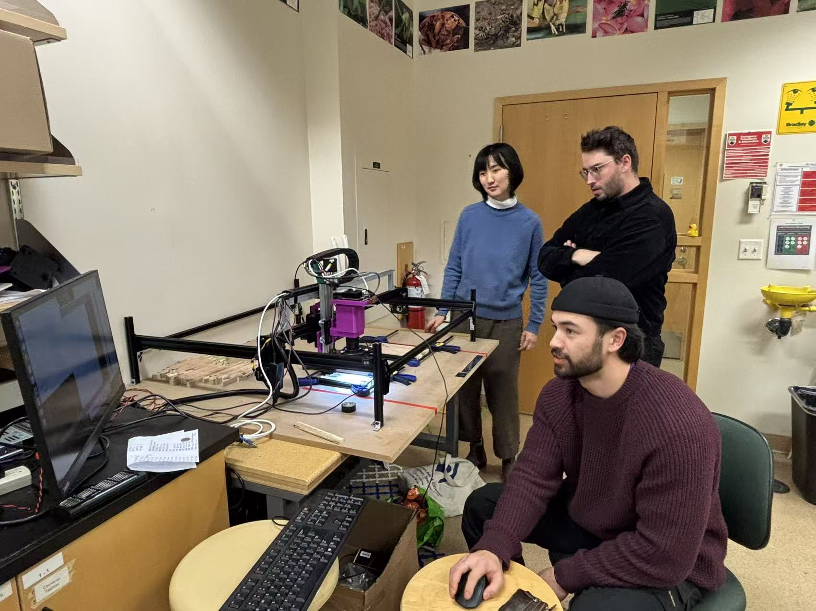
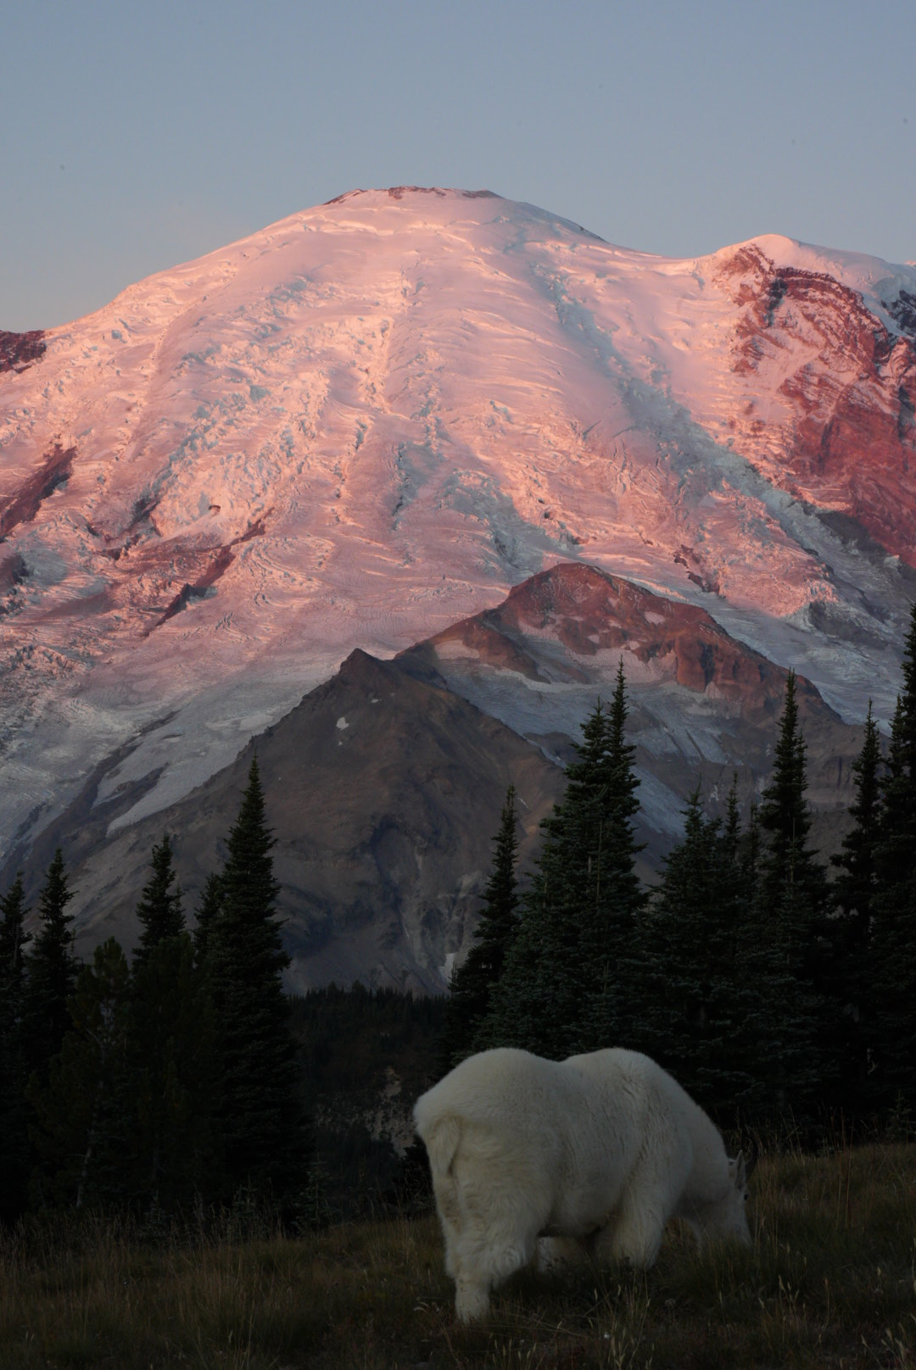

WorkLearn students: Qingyang Deng, Mark Pan, Colette Bennett, Tess Blajberg, Nolan Meier
Notes:
This project wouldn’t be possible without a lot of collaboration — from fieldwork to lab work to data sharing.
I’m incredibly grateful to be part of this team and to work in such a beautiful place.
I’m excited to see what patterns we might see as we analyze the data — and what that can tell us about how trees balance growth and reproduction in a changing climate.

Slide 18
Seed_{j,sp,y} ∼ NegBinomial(λ_{j,sp,y}, ϕ)
The modeled seed count (λ_{j,sp,y}) for stand j, species sp, and year y is:
log_{(λj,sp,y)} = α₀ + α_{sp} + α_{j} + β_{1,sp} ・ Growth_{j,sp,y} + β_{2,sp}・ Growth_{j,sp,y−1} + β_{3,sp} ・ Elevation_{j}

